Slide 1
Counting Statistics for RPTs
An Overview of Concepts Taught in the
Aiken Tech RPT Program
Wade Miller, RRPT, AAHP(A)
Sr. Health Physicist – SRNS
Aiken Tech RPT Program Coordinator
Notes:
RPT-113-4
Nuclear Counting Statistics – Part 1
ACAD-08-006: 1.1.1.2 (partial); 3.2.3.9; 3.2.3.19 (partial); 3.2.3.20 (partial)
DOE: 2.03.01; 2.03.02; 2.03.03a-c; 2.03.04; 2.03.05a-b; 2.03.06; 2.03.14
Duration: 1.5 hour
Material Resources Needed: none
Equipment/Supplies: Overhead display for PowerPoint
Assessment/Evaluation: The teacher should use learning checks periodically throughout the lesson to check for the students’ level of understanding of the topic. The learning outcomes should be reviewed periodically and at the conclusion. Examination number 1 will provide a formal assessment of these learning outcomes.
References Used in Development:
Basic Radiation Protection Technology, 5th edition, Gollnick; ISBN 0-916339-11-4
Nuclides and Isotopes/Chart of the Nuclides, 16th edition, Baum, Knox, Miller; ASIN: B000BUNFS8
Operational Health Physics Training, Moe; ANL-88-26 (1988)
DOE Health Physics Training, DOE-HDBK-1122-99 & DOE-HDBK-1122-2009

Slide 2
Statistical thinking will one day be as necessary for efficient citizenship as the ability to read and write.
~ H. G. Wells

Slide 3
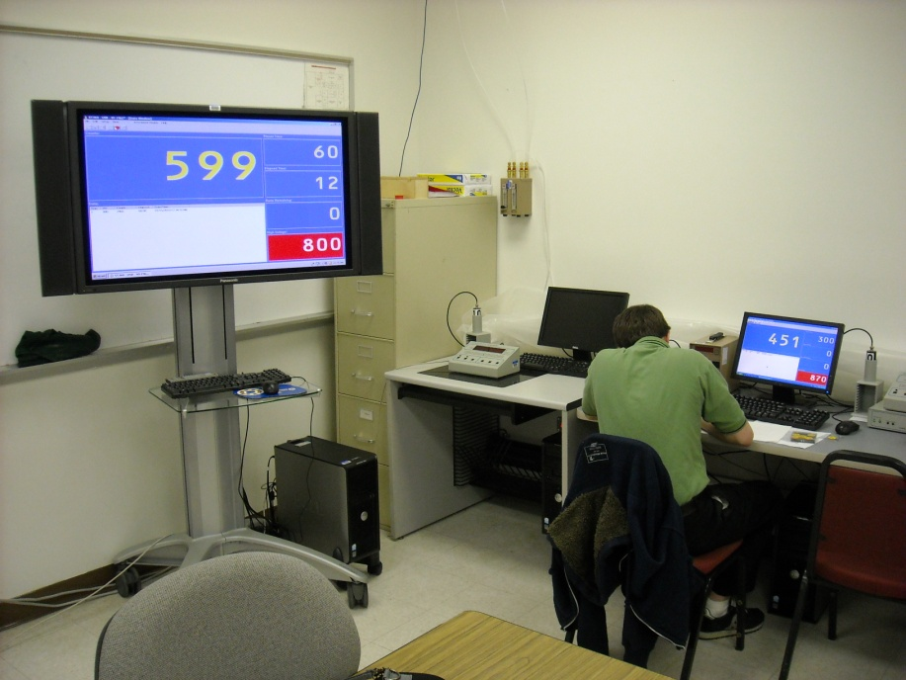
Which Concepts to Teach and Why?
NEI-NUCP
  ACAD 08-006
DOE Core RCT
Gap Analysis
Lectures
Labs & Practical Exercises
Notes:
NEI-NUCP = Nuclear Energy Institute – Nuclear Uniform Curriculum
ACAD 08-006 = National Academy for Nuclear Training Guidelines

Slide 4
Learning Outcome
Upon completion of this lesson, the student will be able to:
Define the term “statistics”
Define and, given a set of data, determine the following terms common to statistics;
  Mean
  Median
  Mode
  Range
Define the following terms:
  Accuracy & Precision
Notes:
RPT-113-4
Nuclear Counting Statistics – Part 1
ACAD-08-006: 1.1.1.2 (partial); 3.2.3.9; 3.2.3.19 (partial); 3.2.3.20 (partial)
DOE: 2.03.01; 2.03.02; 2.03.03a-c; 2.03.04; 2.03.05a-b; 2.03.06; 2.03.14
Duration: 1.5 hour
Material Resources Needed: none
Equipment/Supplies: Overhead display for PowerPoint
Assessment/Evaluation: The teacher should use learning checks periodically throughout the lesson to check for the students’ level of understanding of the topic. The learning outcomes should be reviewed periodically and at the conclusion. Examination number 1 will provide a formal assessment of these learning outcomes.
References Used in Development:
Basic Radiation Protection Technology, 5th edition, Gollnick; ISBN 0-916339-11-4
Nuclides and Isotopes/Chart of the Nuclides, 16th edition, Baum, Knox, Miller; ASIN: B000BUNFS8
Operational Health Physics Training, Moe; ANL-88-26 (1988)
DOE Health Physics Training, DOE-HDBK-1122-99 & DOE-HDBK-1122-2009

Slide 5
Learning Outcomes (cont’d)
Upon the completion of this lesson, the student will be able to:
Describe three types of errors related to counting statistics.
Discuss the nature of radioactive decay as it relates to the need for the use of statistics in radiation protection.
Describe the different types of data distributions and identify the one used in radioactive counting.
Discuss the relationship between variance and standard deviation.

Slide 6
Learning Outcomes (cont’d)
Upon completion of this lesson, the student will be able to:
Given a set of data, determine the variance and standard deviation
Explain the term “propagation of error”
Background
Sample
n_{b}
DL
MDA

Slide 7
Learning Outcomes
Upon completion of this lesson, the student will be able to:
Define the term “Confidence Level (CL)”
Explain how CL relates to standard deviation.
Define “optimum count time”
Demonstrate the ability to determine optimum count time.
Explain the term “Minimum Detectable Activity (MDA)”
Notes:
RPT-113-5
Nuclear Counting Statistics – Part 2
ACAD-08-006: 1.1.1.2 (partial); 3.2.3.19 (partial); 3.2.3.20 (partial); 3.2.3.21; 3.2.3.22
DOE: 2.03.07; 2.03.09; 2.03.10; 2.03.11; 2.03.14; 2.03.15; 2.03.16; 2.03.20; 2.03.21; 2.03.22
Duration: 3 hour
Material Resources Needed: none
Equipment/Supplies: Overhead display for PowerPoint.
Assessment/Evaluation: The teacher should use learning checks periodically throughout the lesson to check for the students’ level of understanding of the topic. The learning outcomes should be reviewed periodically and at the conclusion. Examination number 2 will provide a formal assessment of these learning outcomes.
References Used in Development:
Basic Radiation Protection Technology, 5th edition, Gollnick; ISBN 0-916339-11-4
Nuclides and Isotopes/Chart of the Nuclides, 16th edition, Baum, Knox, Miller; ASIN: B000BUNFS8
Operational Health Physics Training, Moe; ANL-88-26 (1988)
DOE Health Physics Training, DOE-HDBK-1122-99 & DOE-HDBK-1122-2009

Slide 8
Learning Outcomes (cont’d)
Upon completion of this lesson, the student will be able to:
Demonstrate the ability to determine the MDA for a counting system.
Explain the Chi-Square Test
Demonstrate the ability to conduct a Chi-Square Test and interpret the results.
Construct a Quality Control Chart

Slide 9
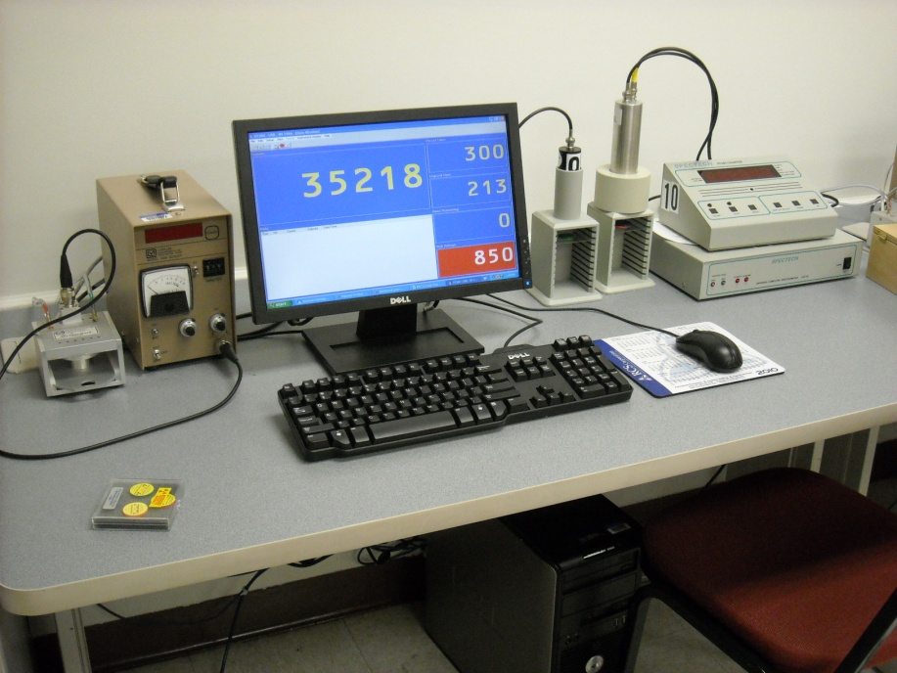
Lab Work & Practical Exercises
GM & Gas Flow Labs
  Operating Voltages
  Backgrounds
    Several measurements
    -> average
  Counting Efficiencies
    CPM -> DPM vs calc’d activity
Lots of WHY?
  Ex. Why more efficient for α vs γ?
α’s, β’s, γ’s – OH MY!

Slide 10
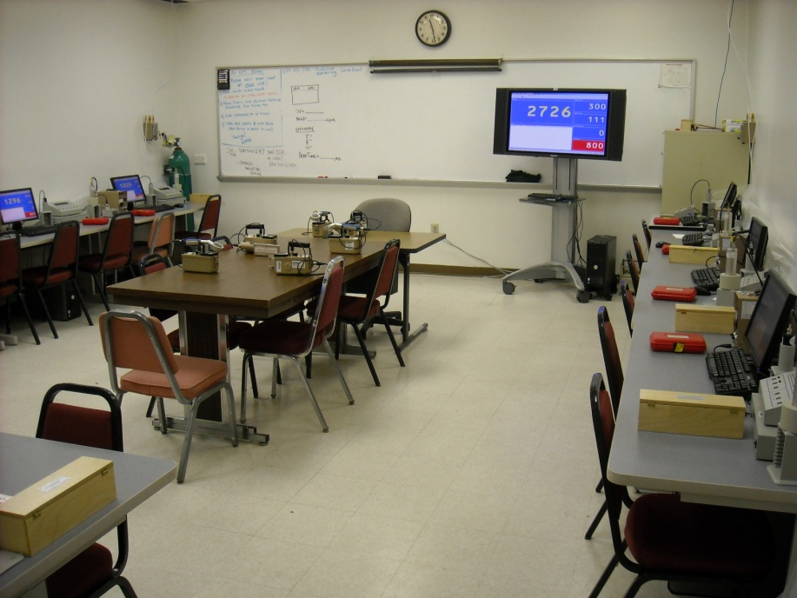
Lab Work & Practical Exercises
Sample Count Time vs Error
  GM detector w/ ¹³⁷Cs
  System MDA
  Optimum Count Time
Quality Control
  Chi Squared Test
  Monthly QC Chart

Slide 11
Know Statistics,
Know Rad Protection…
No Statistics,
No Rad Protection.

Slide 12
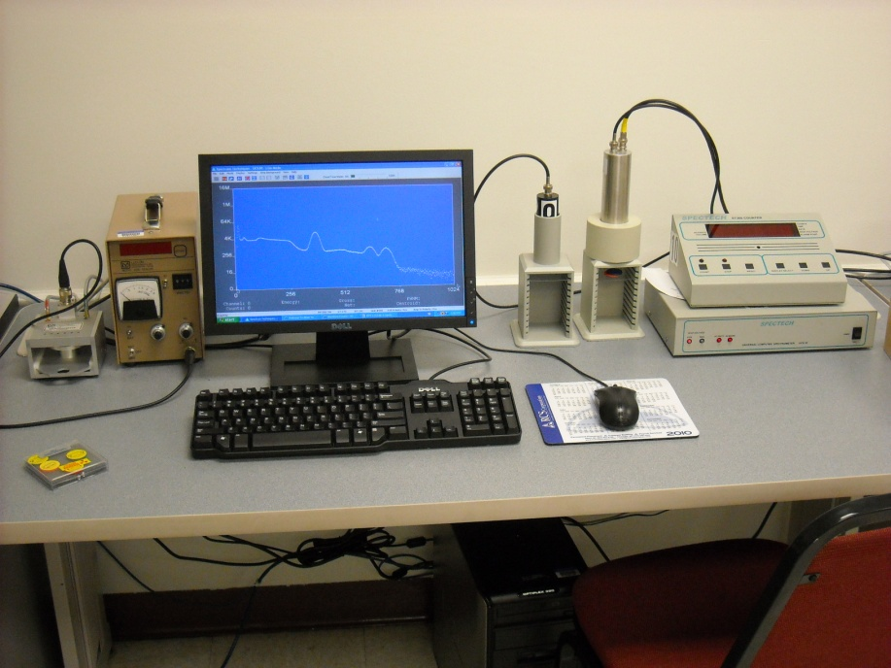
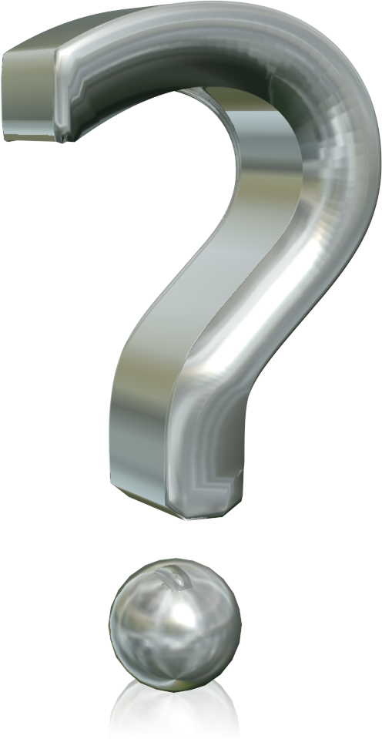
Questions & Answers

